Slide 1
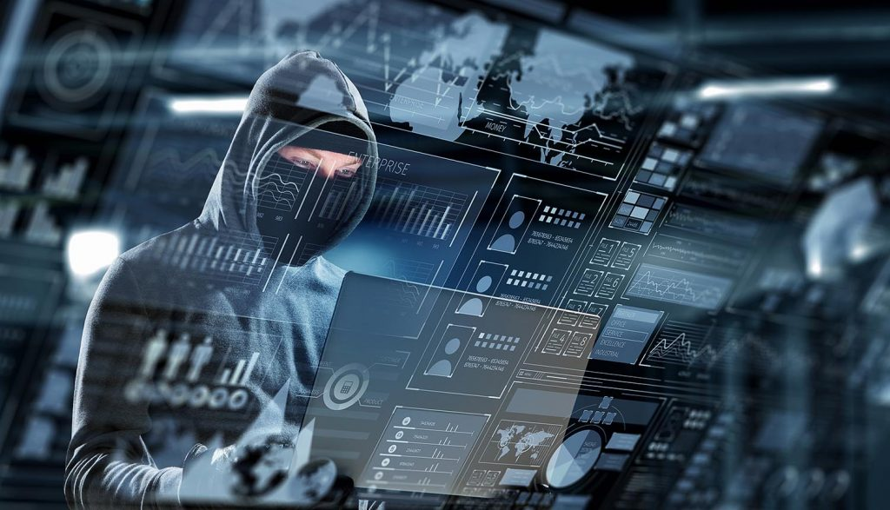
Welcome

Slide 2


Delhi World Public School ‘Etah’
Students of
Presenting
ppt Project
On Cybercrime.
Session 2022-2023
By:-
Aryan Singh
To:-
Rishav Sir.

Slide 3
Let’s Start:-

Slide 4
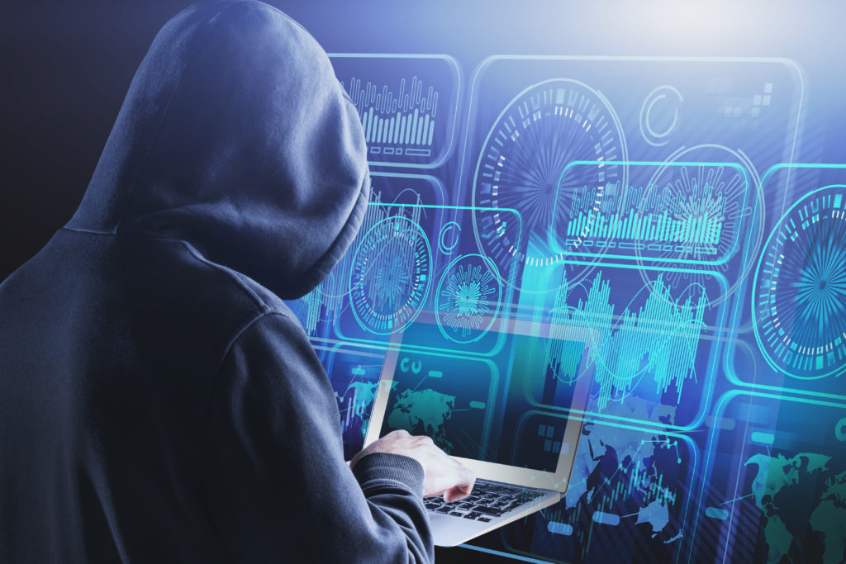
Content:-
Cybercrime.
History and Where it Started.
Why has it increased in the recent years.
Cybercrime recordation.
Countries Impacted by Cybercrime.
Categories of Cybercrime.
Types of Cybercrime.
About Hacker’s.
Prevention from Hacking.
Through this presentation we just want to aware you about Cybercrime that how much dangerous it is. I hope you learn something new from this.

Slide 5
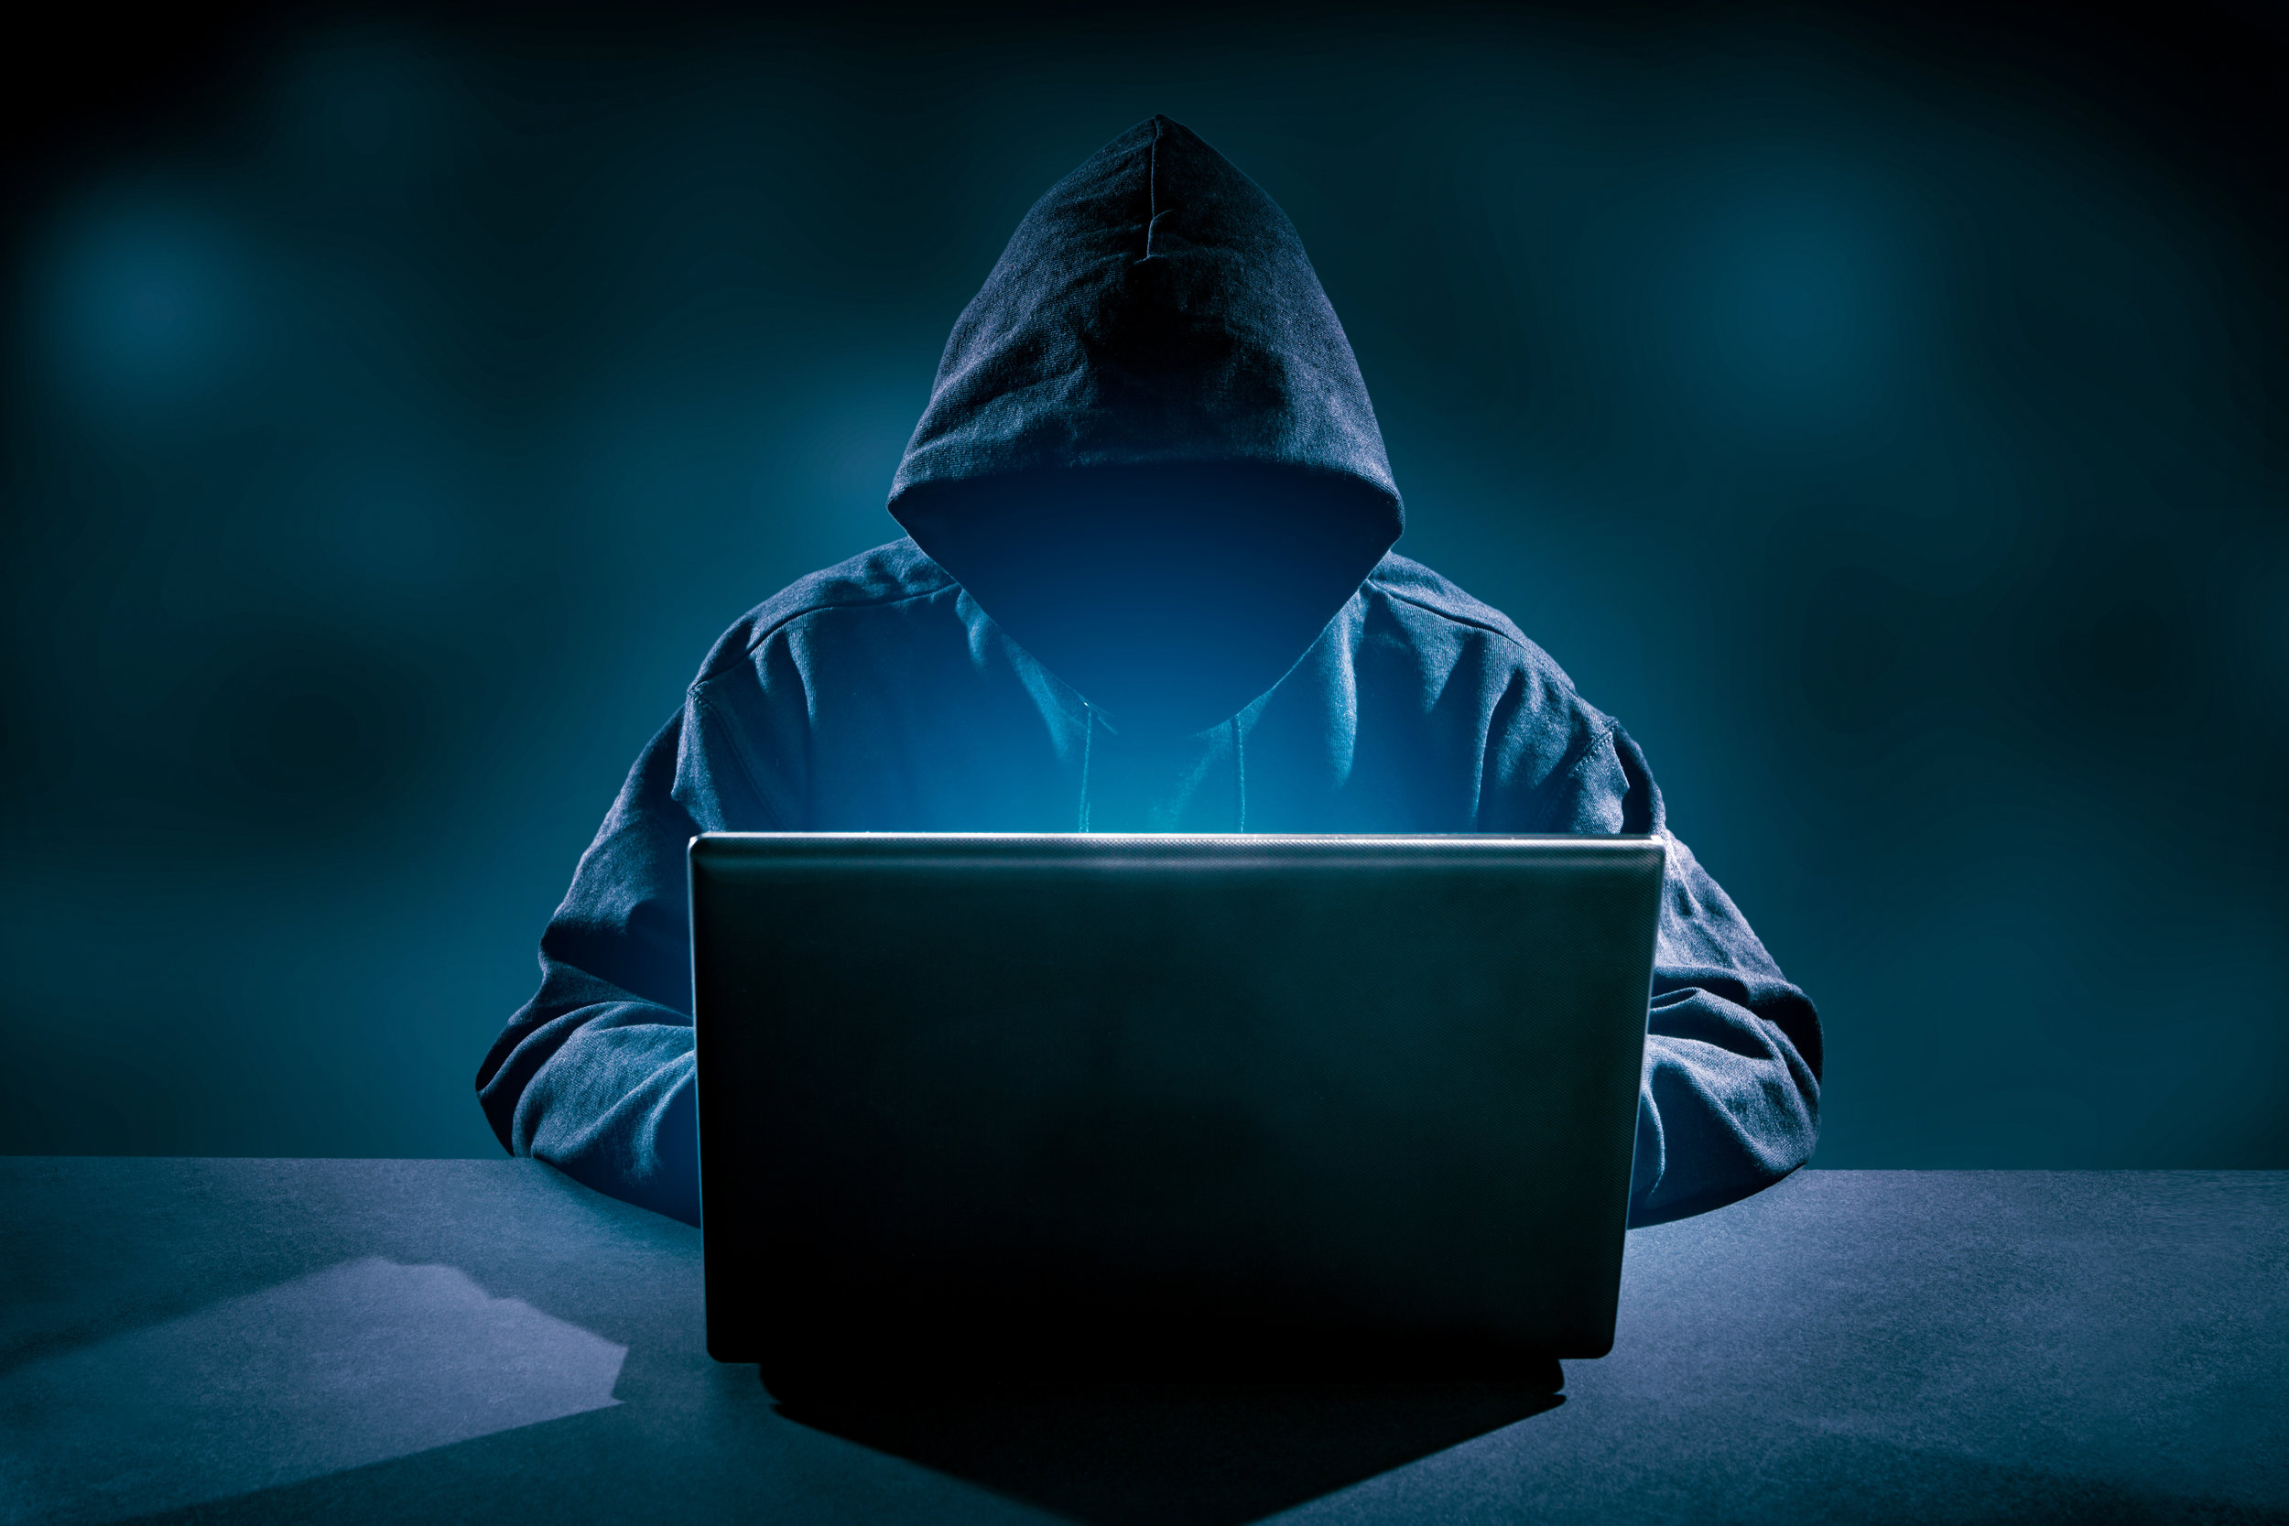
What do you think Cybercrime is??

Slide 6
Cybercrime or computer oriented crime, is a crime that involve a computer and a network. The computer may have been used in the commission of a crime, or it may be the target. Cybercrime may threaten a person, company or a nation’s security and financial health.

Slide 7
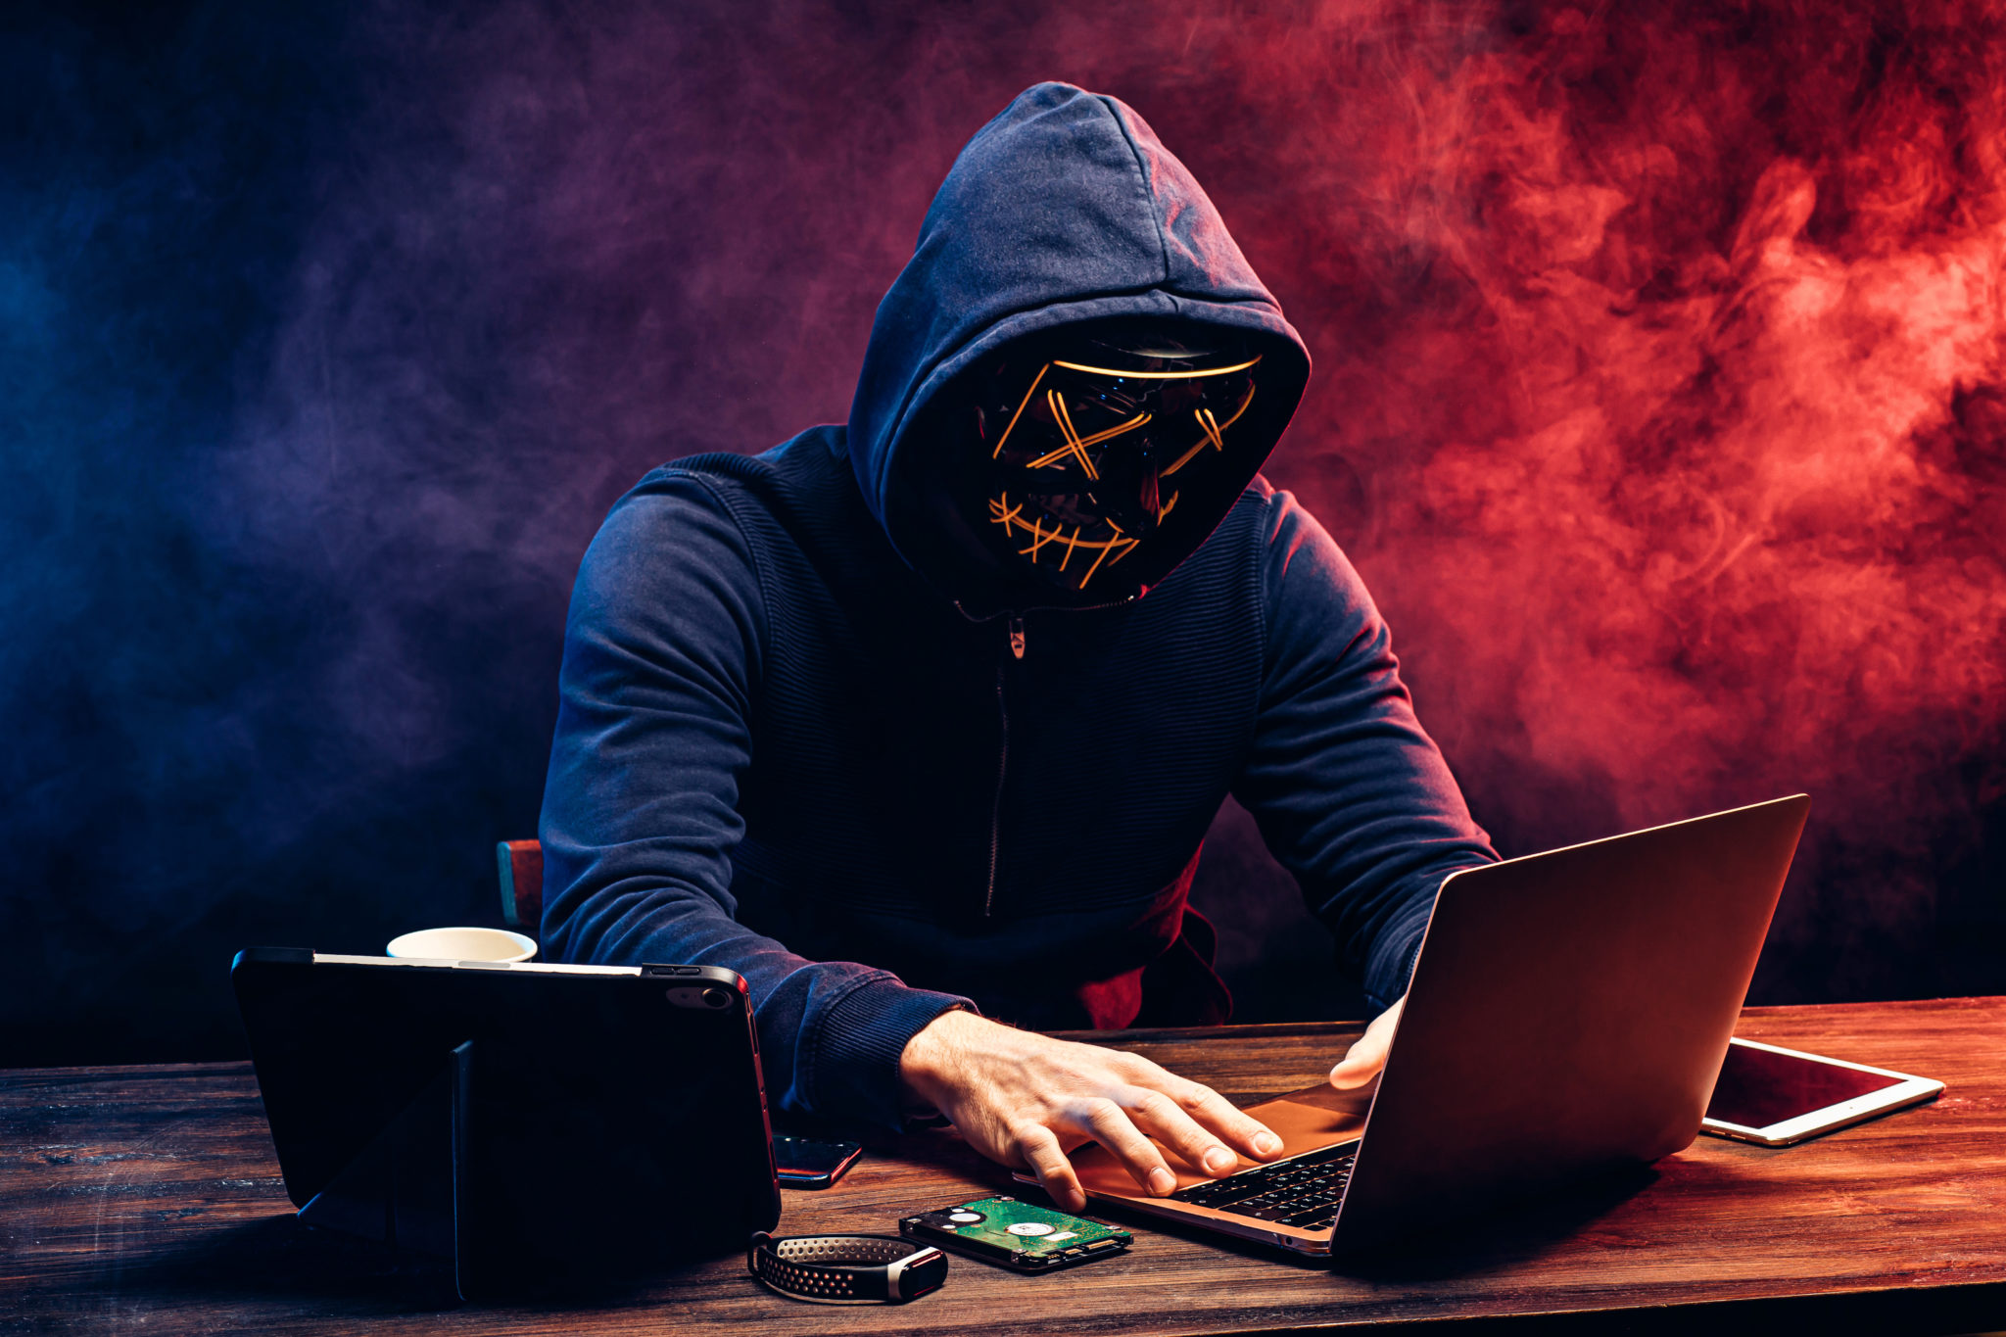
History and where it started.

Slide 8
The extract origin of cyber crime, the very first instance in which some one committed a crime across a computer network, is impossible to know.
First case of use of computer for theft was in 1973, A teller at a local New York bank used a computer to embezzle over $2 million dollars.
The first spam email took place in the year 1928.

Slide 9
The first virus was installed on apple computer in the year 1982.
In 1981, Ian Murphy, known's as the captain zap to his fans, was the first person convicted of a cybercrime.
He hacked in the AT&T network and changed the internet clock to change off-hours rates of peak times.
He received 1000 hours of community service and 2.5 years of probation, a mere slap on the wrist compared to today’s penalties, and was the inspiration for movie sneakers.

Slide 10
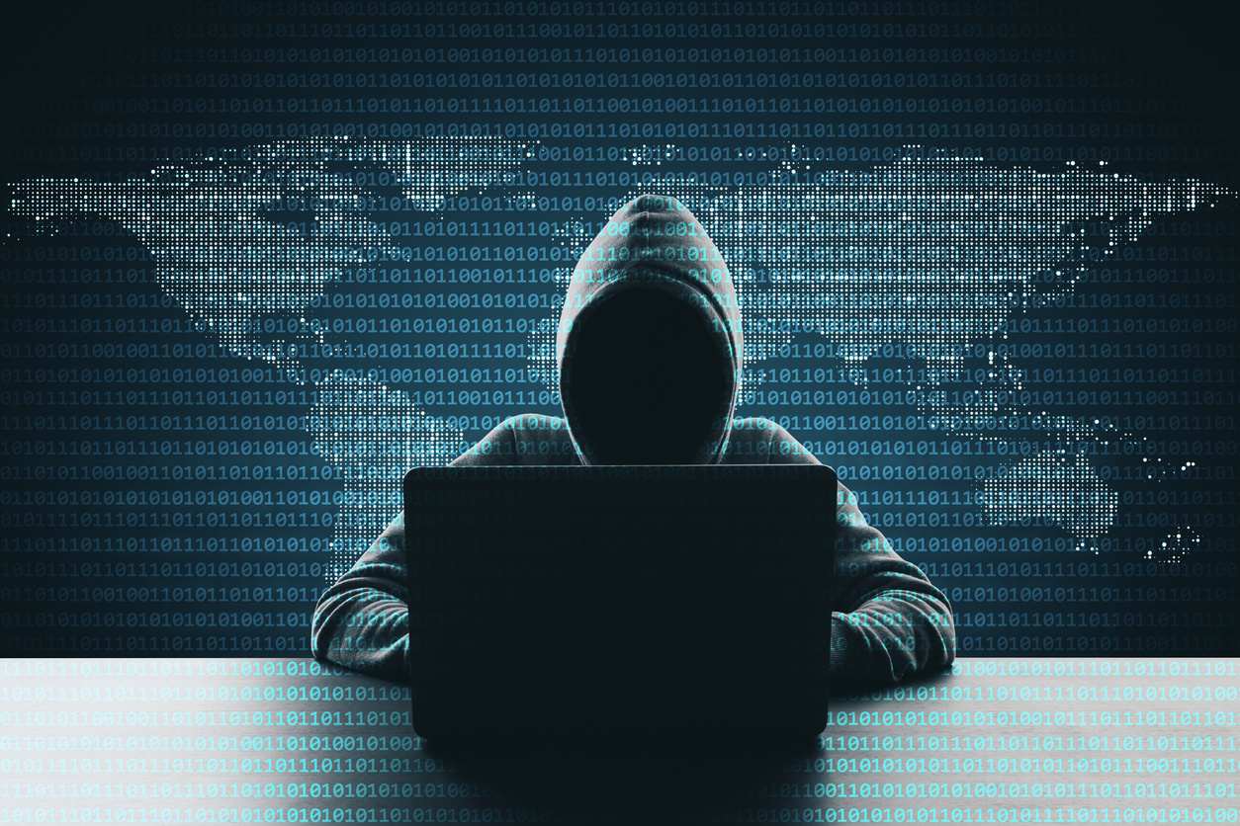
Why has it increased in the recent year??

Slide 11
Increased level of connectivity, remote working on technology and automation have increased the frequency of Cybercrime.
Also, Cybercriminals have used the corona virus pandemic for their crime. Last year when the whole world took to the online medium due to the Corona virus pandemic the frequency of Cybercrime increased.
Cybercriminals are developing and boosting their attack at an alarming pace, exploiting the fear and uncertainty caused by the unstable social and economic situation created by Covid-19.

Slide 12
A report (sponsored by McAfee), published in 2014, estimated that the annual damage to the global economy was $445 billion.
Approximately $1.5 billion was last in 2012 to online credit and debit card fraud in the US.
In 2018, A study by Center for Strategic and International Studies (CSIS), In partnership with McAfee, concludes that close $600 billion, nearly one percent of global GDP, is lost to cybercrime each year.

Slide 13

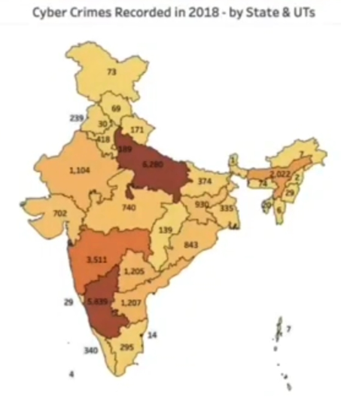
Cybercrime recorded in 2019 - In India.
The NCRB’s data stated that ’44,546’ cases of cybercrime were registered in 2019 as compared to ’28,248’ in 2018.
In 2019, highest number of cybercrime cases were registered in Karnataka(12,020), followed by Uttar Pradesh (11,416), Maharashtra (4,967), Telangana (2,691) and Assam (2,231).
Among the union territories, Delhi alone accounted for 78 percent of cybercrime.

Slide 15
Top 20 Country impacted by Cybercrime.

Slide 17




Categories of Cybercrime.
Crime against Property.
Crime Against People.
Crime against government.

Slide 18
Crime against People.
These crime include harassment and stalking, Credit card fraud, human toofficking, spoofing, identity theft, and online libel or slander.

Slide 19
Crime against property.
Some online crime occurs against property, such as a computer or server. These crimes include DDOS attack, locking, virus transmission, cyber and typo squatting, computer vandalism, copyright infringement, and IPR violence.

Slide 20
Crime against Government.
When a cybercrime is committed against the government include hacking, accessing confidential information, cyber warfare, cyber terrorism, and pirated software.

Slide 21
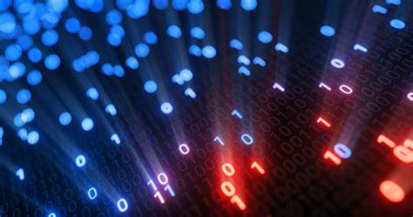
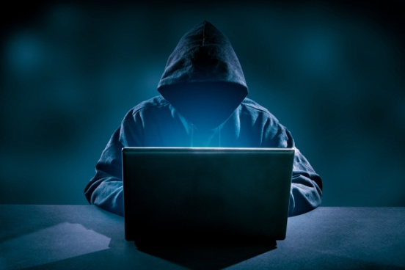

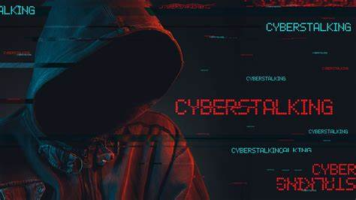
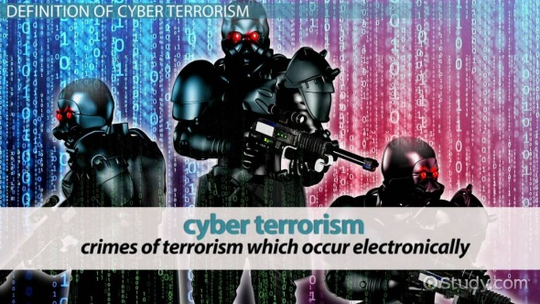

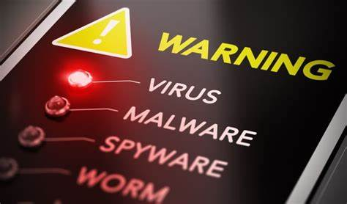
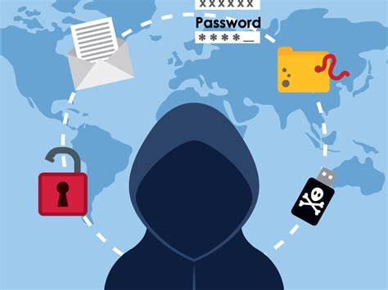
Types of Cybercrime.
Hacking
Spamming and phishing
Cyber Stalking
Cyber Terrorism
Software Piracy
Virus Dissemination
Identity Theft

Slide 22
Hacking
It is an attempt to exploit a computer system or a private network inside a computer. Simply put, it is the unauthorized access to or control over computer network security system for some illicit purpose.
A Hacker is someone who explores methods for breaching defense and exploiting weakness in a computer system or network.

Slide 23
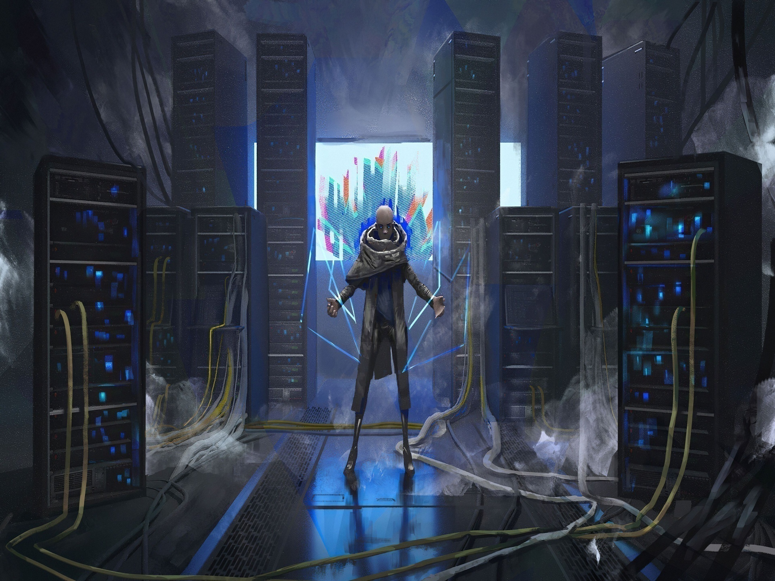
Software Piracy.
It is the act of stealing software that is legally protected. This stealing include copyright, distribution, modifying or selling the software.

Slide 24
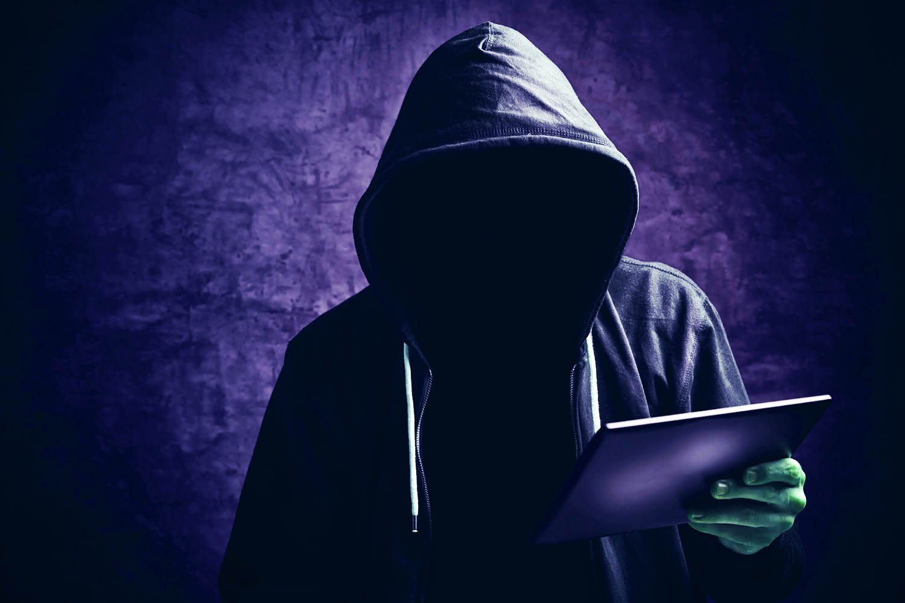
Spamming
It is the use of messaging System to send an unsolicited message to large numbers of recipients for commercial advertising, for non-commercial proselytizing, or for any prohibited purpose.
In phishing emails, cyber criminals will typically ask for your.
Date of birth
Phone number
Home Address
Social Security Numbers
Credit Card Details.
Password information (or what they need to reset you password)

Slide 25

Identity theft.
Identity theft occurs when someone uses another personal identifying information, like their name, identifying number or credit card number without their permission, to commit fraud or other crime. The term identity theft was coined in 1964.
Financial identity theft
It is by for most common type of identity theft.
In 2014, identity thieves stole $16 billion from 12.7 million identity fraud victims. According to javelin strategy and research.

Slide 26

Virus Dissemination.
It is a process of a malicious software that that destroys the system of victim. They disrupt the computer operation and affect the data store by modifying or deleting it.

Slide 27
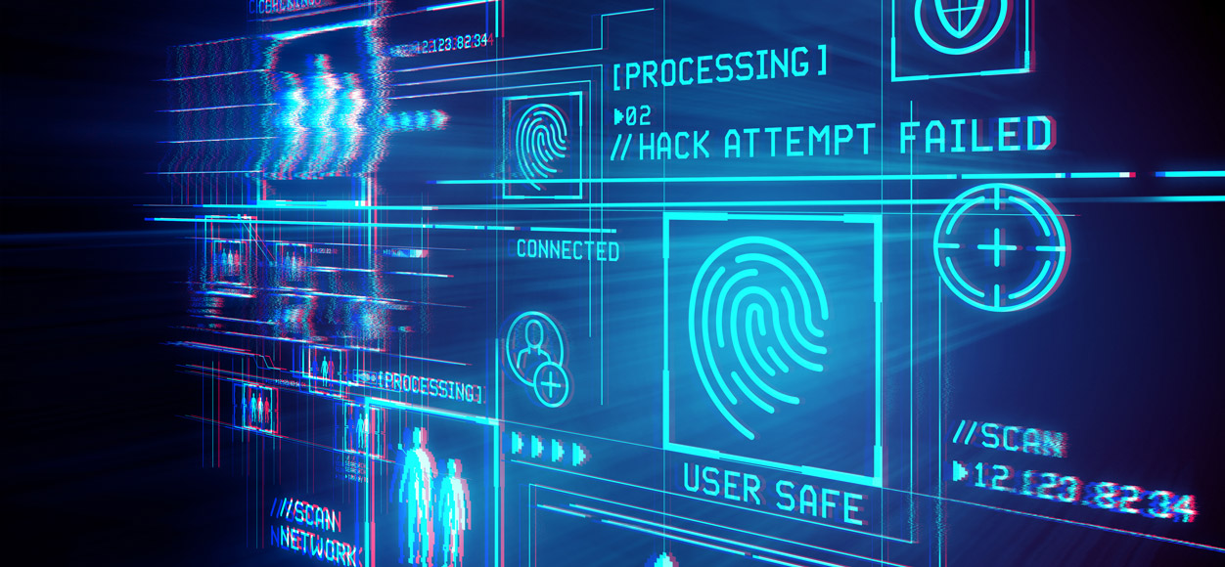
Cyber Stalking.
It is the use of the internet or other electronic means to stalk or harass an individual, groups, or organization. It may include false accusation, defamation, slander and libel.

Slide 28
Cyber Terrorism.
It is the use of internet to conduct violent acts that result in, or threaten, loss of life or significant bodily harm, in order to achieve politically or ideological gains through threat or intimidation.

Slide 29
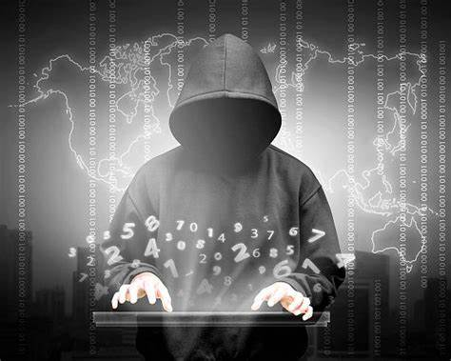
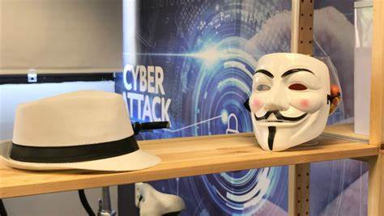
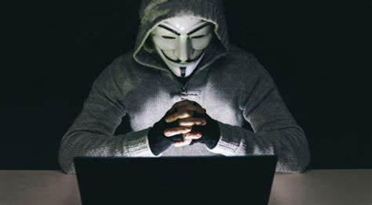
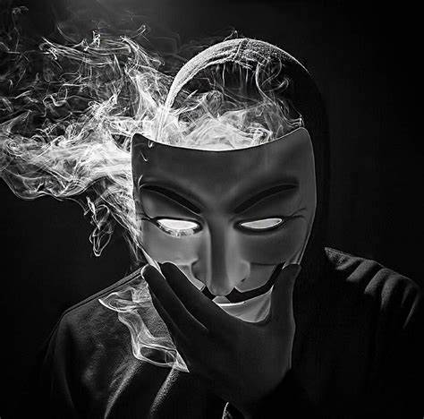
Who are hacker??
A person who uses computers to gain unauthorized access to data.
Types of hacker’s??
White Hat Hacker.
Gray Hat Hacker.
Black Hat Hacker.

Slide 30
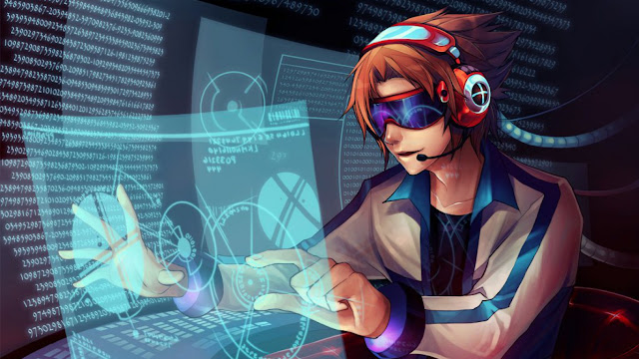
White Hat Hacker:-
A white hat (or a white-hat hacker, a white hat) is an ethical security hacker. Ethical hacking is a term meant to imply a broader category than just penetration testing. Under the owner's consent, white-hat hackers aim to identify any vulnerabilities the current system has.

Slide 31

Grey Hat Hacker:-
A grey hat (greyhat or gray hat ) is a computer hacker or computer security expert who may sometimes violate laws or typical ethical standards, but usually does not have the malicious intent typical of a black hat hacker. The term came into use in the late 1990s, derived from the concepts of "white hat" and "black hat" hackers.

Slide 32
Black Hat Hacker:-
A black hat hacker historically has been used to describe one who has malicious intent -- such as theft of information, fraud or disrupting systems -- but increasingly, more specific terms are being used to describe those people.

Slide 33

Now Question Raised how to prevent Cybercrime??

Slide 34


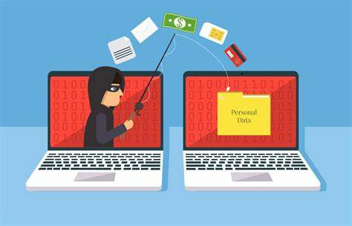
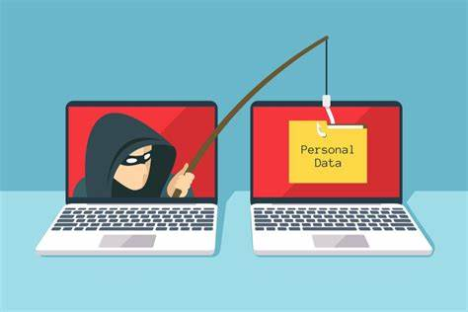

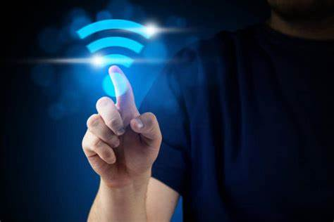

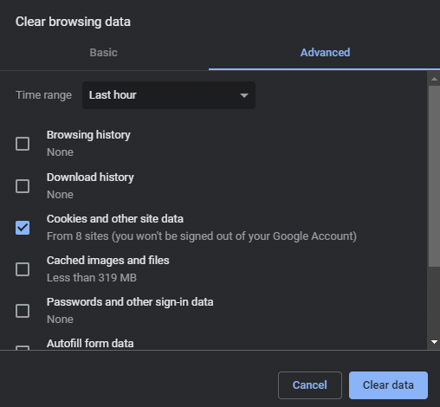



Steps to prevent Cybercrime are listed below:-
Identity Protection.
Protect Username and Password.
Do not share Personal Information.
Secure online Transition.
Avoid using Unsecured Wi-Fi.
Don’t Accept Unknown Invitation.
Use Antivirus and Antispyware Software.
Clear Browser Cookies Frequently.
Install Firewall.
Never Install Software from Unknown Sources.
Use Strong Password.

Slide 35

How to Report Incidents to CERT-In
Visit the website www.cert-in.org.in
Click on the ‘Incident Reporting’ link.
Double click on the ‘Security Incident Reporting Form’ link & download the incident reporting form.
Fill the relevant details in the form and send it to CERT-In through:
Email: incident@cert-in.org.in
Or Fax: +91-11-24368546
Or Post: Indian Computer Emergency Response Team (CERT-In), Ministry of Electronics and Information Technology, Government of India, Electronics Niketan, 6 CGO Complex, Lodhi Road, New Delhi 110003, India.

Slide 36
Fact of the Day:
At the end:-
The First virus that attacked MS-DOC is called brain and was written by two brothers, Basit Farooq Alvi and Amjad Farooq Alvi, from Lahore, Punjab, Pakistan in 1986.
Security awareness training reduces a company’s risk of a cyber security incident by 70%.

Slide 37

Thank You

